Slide 1

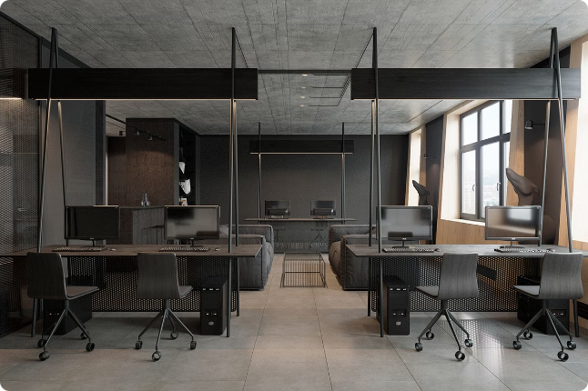
Welcome to My Design Portfolio
I'm a passionate and experienced web designer with a proven track record of creating visually stunning and user-friendly websites. Explore my portfolio to discover my design process and diverse projects.

Slide 2


About Me
My Background
My Passion
I hold a degree in Graphic Design and have been working in the web design industry for over 5 years, specializing in user interface design, branding, and responsive web development.
I am passionate about creating beautiful and functional websites that enhance user experiences and meet the needs of my clients.
My Skills
My skillset includes proficiency in various design software like Adobe Creative Suite and Figma, along with knowledge of HTML, CSS, and JavaScript.

Slide 3

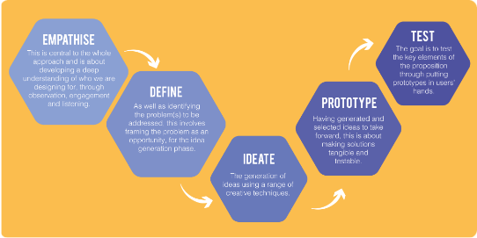
My Design Philosophy
1
User-Centric Approach
2
Clean and Minimalist Aesthetics
I prioritize user experience by conducting thorough research and usability testing to ensure my designs are intuitive and engaging.
I believe in creating clean and minimalist designs that focus on functionality and clarity, while still maintaining visual appeal.
3
Responsive Design
4
Data-Driven Design
I create websites that adapt seamlessly to different screen sizes and devices, ensuring optimal viewing and user experience across all platforms.
I leverage data analytics and user feedback to refine my designs and make informed decisions.

Slide 4
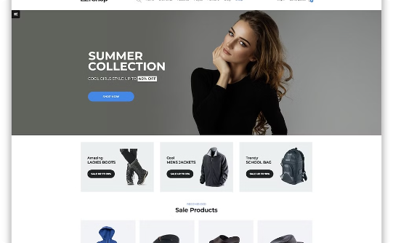
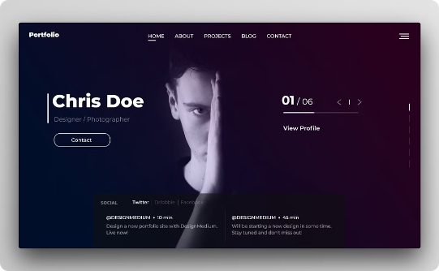
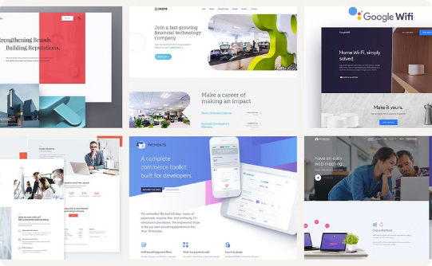
Featured Projects
E-Commerce Website
Portfolio Website
Corporate Website
This project involved designing a modern and user-friendly e-commerce website for a clothing brand, optimizing the user journey and showcasing products effectively.
I designed a visually compelling portfolio website for a freelance photographer, highlighting their best work and showcasing their creative vision.
This project involved creating a professional and informative corporate website for a technology company, focusing on clear communication and brand identity.

Slide 5
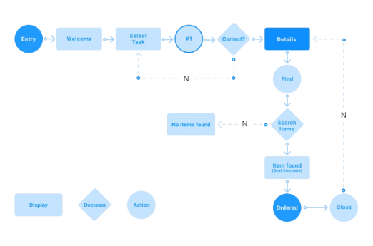
User Interface Design
User Interface (UI) Design
Design Tools
UI Design Process
I specialize in designing user-friendly and visually appealing interfaces that enhance user experience and promote engagement.
I utilize a range of design tools to create high-quality UI designs.
My UI design process involves a user-centered approach, incorporating research, wireframing, prototyping, and testing to ensure optimal usability.
Figma
Adobe XD
Sketch
Wireframing and Prototyping
InVision Studio
Interactive Design
Information Architecture
Visual Design and Branding

Slide 6


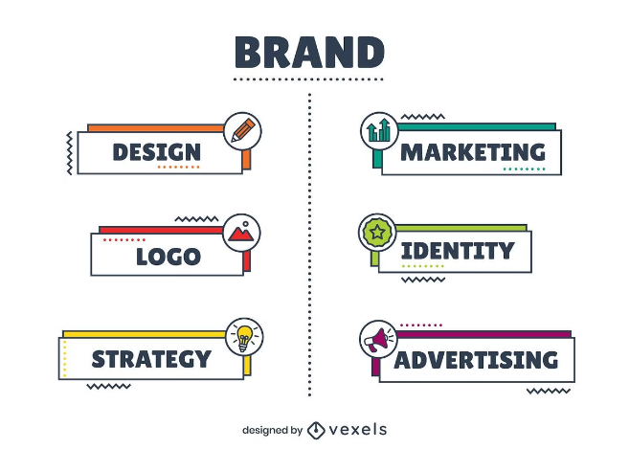



Branding and Identity
Brand Strategy
I work closely with clients to understand their target audience, values, and brand message.
Logo Design
I create unique and memorable logos that represent the brand's identity and resonate with the target audience.
Brand Guidelines
I develop comprehensive brand guidelines to ensure consistency across all brand touchpoints, including color palettes, typography, and imagery.
Brand Applications
I apply brand elements across various marketing materials, websites, and social media platforms.

Slide 7

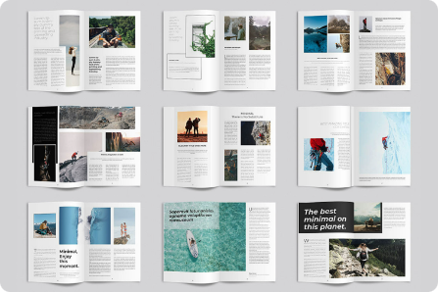
Print and Editorial Design
Brochures
Flyers
Posters
Catalogs
Magazines
Newsletters
I have experience designing a wide range of print materials, ensuring high-quality visuals and effective communication.

Slide 8

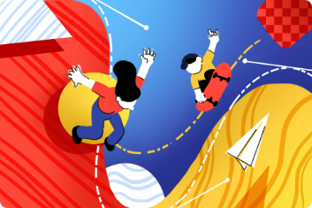
Motion Graphics and Animation
Storyboarding
1
I create visual storyboards to plan the animation sequence and ensure smooth transitions between scenes.
2
Animation Design
I utilize animation software to bring the storyboards to life, creating engaging and dynamic visuals.
Sound Design
3
I incorporate sound effects and music to enhance the visual experience and create a cohesive narrative.
I enjoy creating dynamic and engaging motion graphics and animations to enhance brand storytelling and captivate viewers.

Slide 9

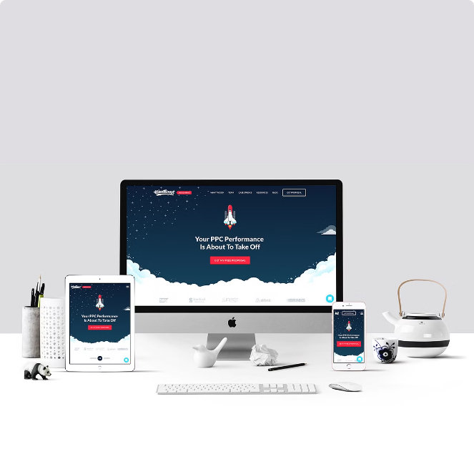



Responsive Web Design
Mobile Optimization
I ensure websites are fully responsive and optimized for various screen sizes, providing a seamless user experience on mobile devices.
Tablet Compatibility
I design websites that adapt to tablet screens, ensuring optimal navigation and readability.
Desktop Functionality
I create websites that are visually appealing and functional on desktop computers, providing a comprehensive user experience.
I am committed to creating responsive websites that provide a consistent and enjoyable user experience across all devices.

Slide 10

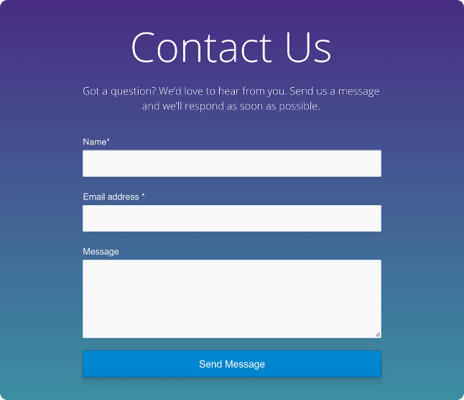
Contact and Next Steps
Ready to discuss your project? Get in touch with me through my website or social media channels. I look forward to collaborating with you to create impactful and engaging designs.

